Slide 1

Phishing Attack Lesson Plan
Ambrey De La Roca, Latrunda Smith, Nicole Bellio Centa

Slide 2
Simulation
Results
ENTER

Slide 3
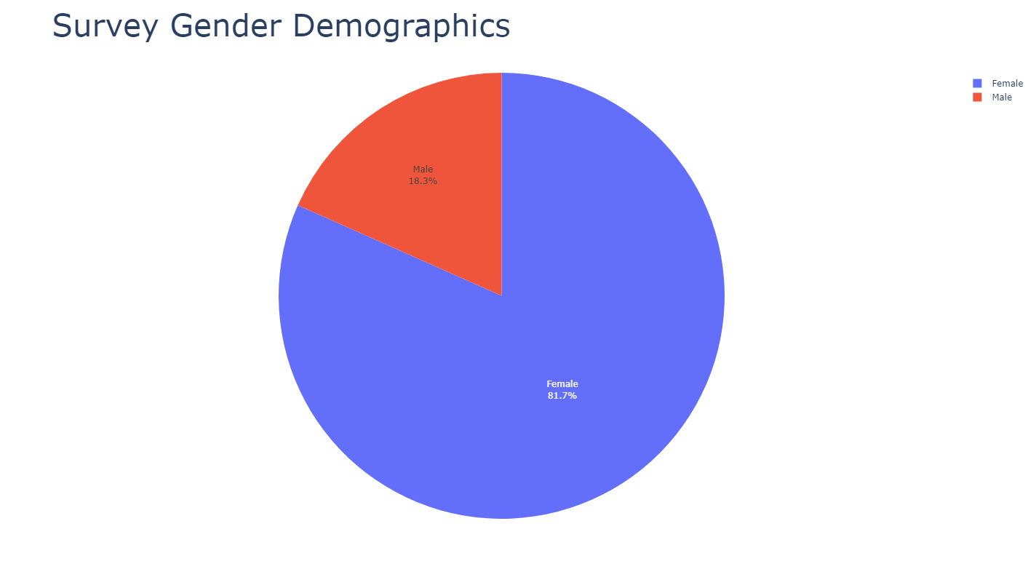
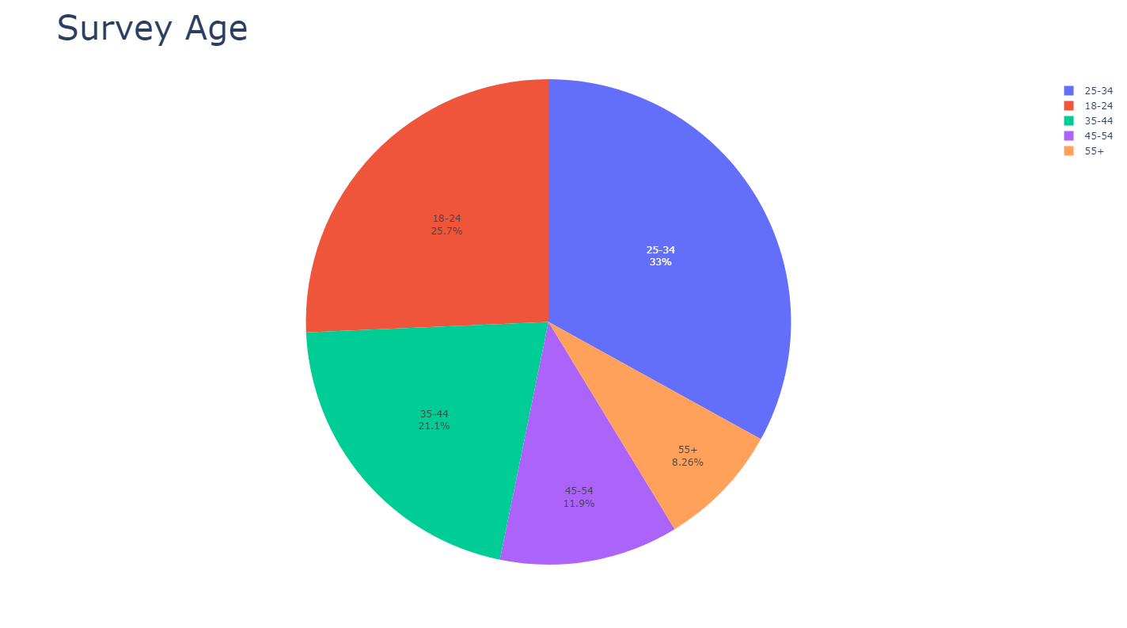
Survey Results
81.7% of the users who participated in our survey were Female, and 18.3% of the users were male.
Users falling in the age range of 25-34 had the highest participation rate in the survey at 33%.

Slide 4
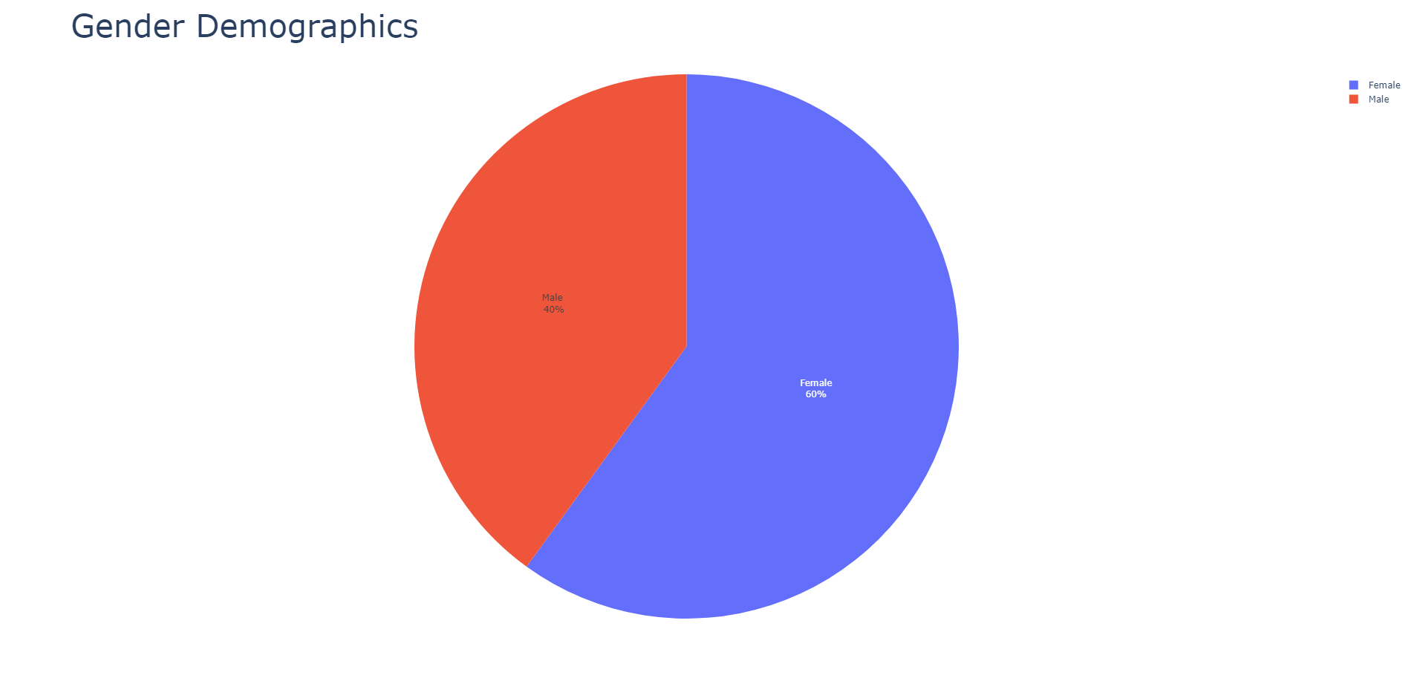
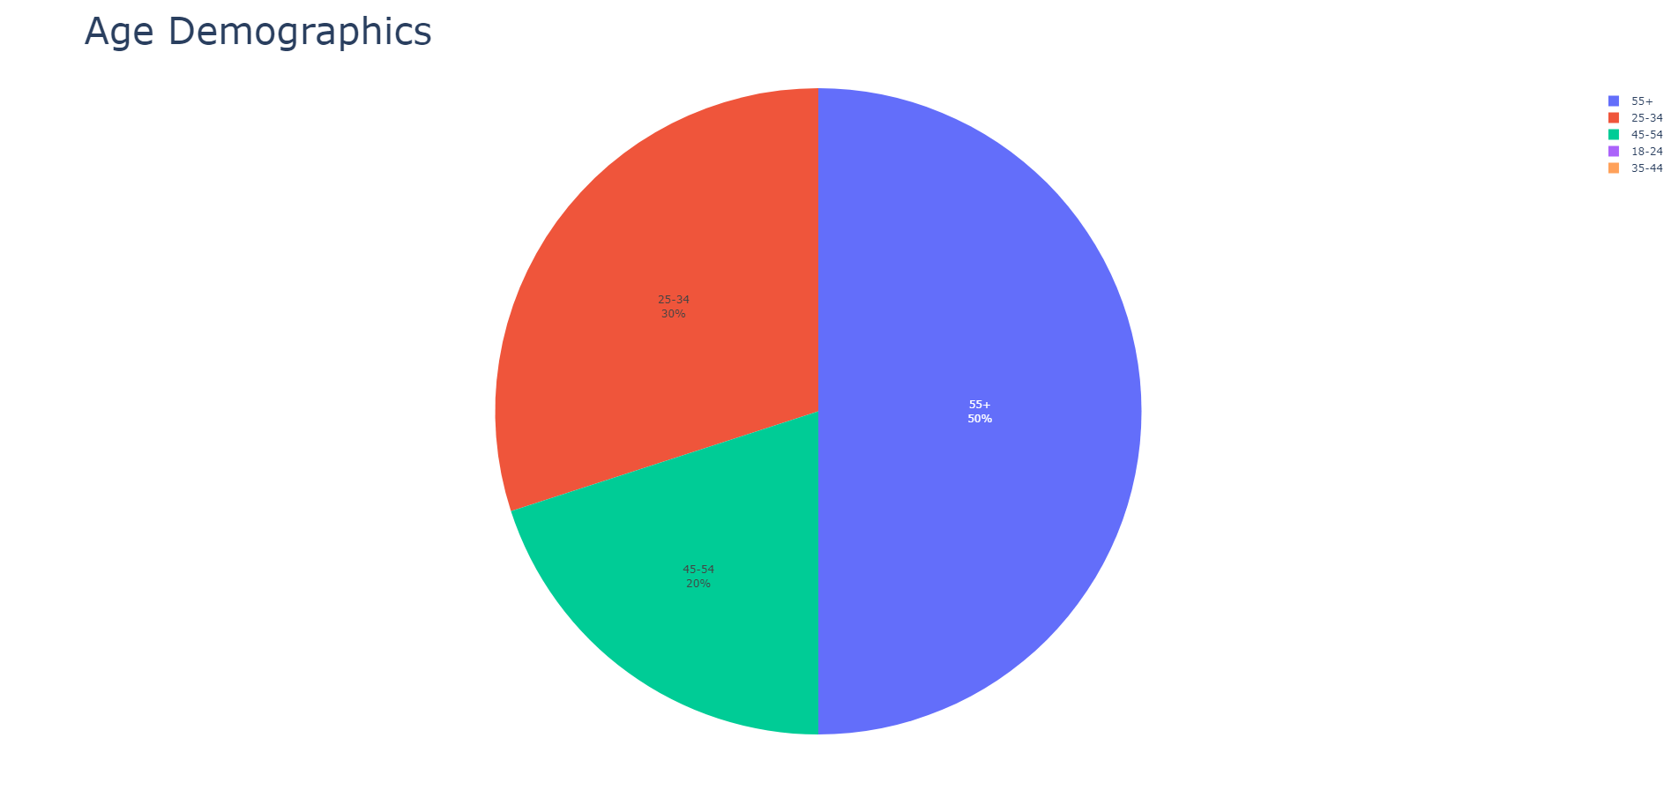
Phishing Simulation Results
60% of the users who clicked on the phishing simulation were Female, and 40% of the users were male.
Users falling in the age range of 55+ were the most vulnerable to the phishing simulation, accounting for 50% of the clicks

Slide 5
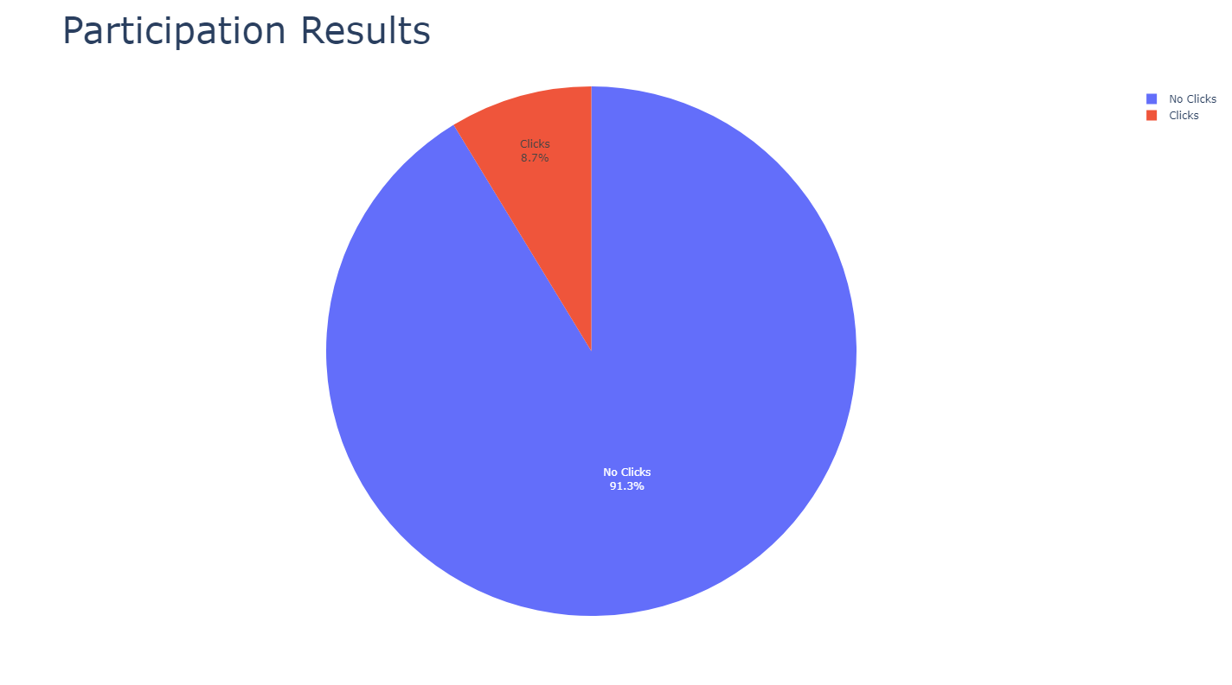
Phishing Simulation Results
Out of the 115 people who participated in the survey, only 8.7% percent of users clicked on and fell victim to the simulation.

Slide 6
What Are Phishing Attacks?
ENTER

Slide 7


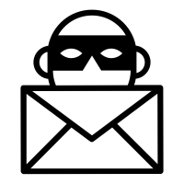

Different Types of Phishing Attacks
Email Phishing
Email Phishing can be considered the blanket term for other types of phishing attack. Any email that is sent to steal information or install malware on a user’s device is considered an email phishing attack.
Whaling
Whaling attacks appear more often within companies or organizations. These attacks impersonate supervisors or corporate executives in order to target all of the employees who receive the emails. Since an executive appears to send the email, the sense of urgency makes the attack successful
Spear Phishing
Spear phishing is a type of email phishing attack, however it is more personalized and is usually sent to small groups of targets. Attackers research their targets in order to personalize these emails and make them more familiar to the targets.
Angler Phishing
Angler attacks impersonate customer service representatives and target customers who have written reviews or filed complaints about a product or service. Since transactions have taken place, attackers will attempt to steal login credentials or payment information.

Slide 8
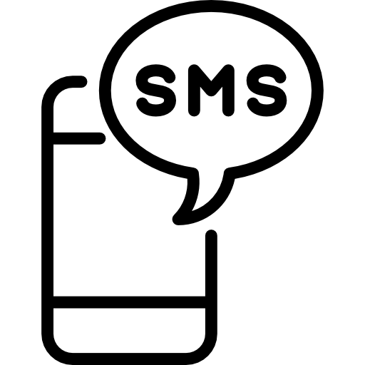

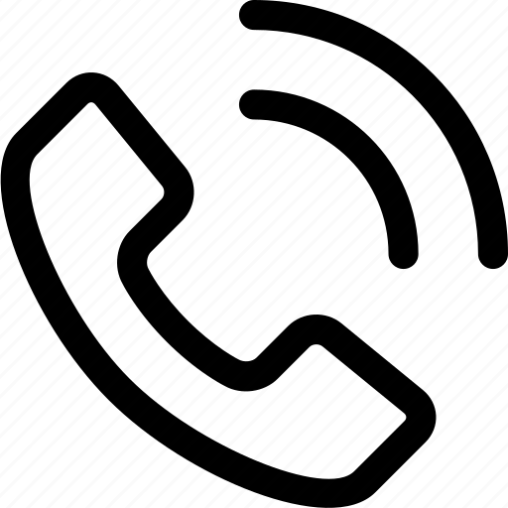

Different Types of Phishing Attacks
Smishing
Smishing uses SMS text messages as the primary form of attack. Many smishing attacks will provide a return number to call or a link to follow. Common types of messages that are sent are fake discounts to claim or compromised account notifications.
URL Phishing
URL Phishing attacks target users with fake websites that are made to resemble real pages such as Facebook or Amazon. Common information that is stolen using these attacks are login credentials, with malware also being frequently installed.
Vishing
Similar to smishing attacks, vishing primarily targets mobile devices. Vishing attacks take place in the form of a voice call urging users to provide sensitive information such as account details, social security numbers, etc.
Pretexting
Pretexting can be used through mobile and desktop devices, and tend to target a user’s emotions as a vulnerability. The attacker takes on a role and the added apparent humanity of the attack makes it more successful.

Slide 9
How Successful Are Phishing Attacks
83%
97%
75%
93%
Studies show that 83% of organizations have been targeted by phishing attacks
97% of employees and users fall for at least one type of phishing attack
Of all emails sent day to day, 75% are spam emails
Attackers use social engineering for various purposes, but 93% of attacks are related to phishing

Slide 10
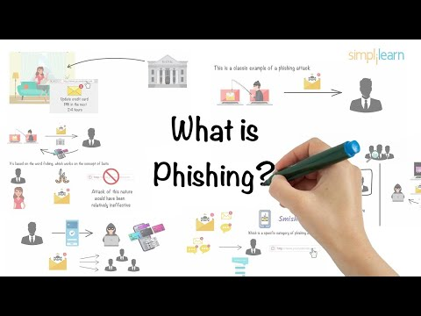
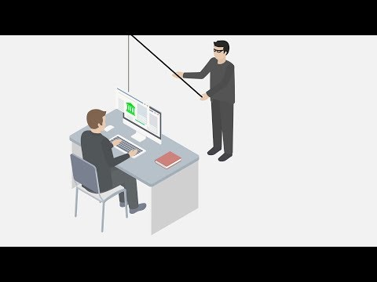
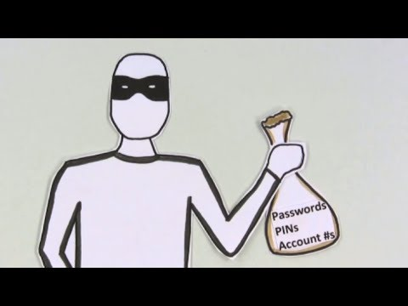
How Email Phishing Attacks Work
Notes:
© Copyright PresentationGO.com – The free PowerPoint and Google Slides template library

Slide 11







What Is At Risk?
01
05
CONTACT INFORMATION
CONFIDENTIAL COMMUNICATION
02
06
FINANCIAL DATA
PRODUCT SECRETS
03
07
MALWARE INFECTIONS
ACCOUNT LOGIN INFORMATION
04
08
MEDICAL RECORDS
CUSTOMER INFORMATION
Notes:
© Copyright PresentationGO.com – The free PowerPoint and Google Slides template library

Slide 12


Ways to Detect a Phishing Email Attack
SENT FROM PUBLIC EMAIL
REQUESTING INFORMATION
Make sure that the sender’s email address is not a public domain such as “@gmail.com” or “@yahoo.com”. Organization often have their own internal domains.
Beware of emails from unknown senders that are requesting login credentials or account information. Senders simply introducing themselves as corporate executives are not always legitimate.
SUSPICIOUS LINKS
SEND TIME
Plain-looking emails with odd hyperlinks should raise red flags. Important procedures such as confirming account information are typically done over the phone or in person.
Phishing emails can be automated, so keep an eye on the send time and date. Any emails sent in the middle of the night should appear as suspicious.
SPELLING ERRORS
SENSE OF URGENCY
Billion-dollar organization like Facebook and Google can afford to have a spell checker. Errors and inconsistencies in emails point to spam message.
Phishing emails always push for a sense of urgency when trying to obtain important information. An example would be “Click to reset password before account is deleted”.
Notes:
© Copyright PresentationGO.com – The free PowerPoint and Google Slides template library

Slide 13


How to Stay Safe From Phishing Scams
Reply to email requests quickly
Install antivirus programs & firewalls
Do not respond to any critical email requests without verifying the sender first. If an executive emails you requesting sensitive information, verify the request with them directly before sending the information.
Firewalls will act as a primary filter against malicious material that is sent to your device. If a user becomes a victim to a phishing attack, antivirus programs provide an extra boost of protection.
Perform cross checks with accounts
Send personal information via email
If you receive a suspicious email regarding financial information, double-check your bank accounts in order to catch any indiscrepancies quickly and report incidents to your bank.
NEVER send personal information via email. If a coworker or executive requests information via email, provide any sensitive information directly or through a secure method.
Notes:
© Copyright PresentationGO.com – The free PowerPoint and Google Slides template library

Slide 14
How to Stay Safe From Phishing Scams
Open unknown email attachments
Look at the details
If you receive an unexpected email attachment, do not open it. Make sure that an attachment scanner is installed on your device to do a pre-screening for malicious content before opening or downloading the file.
Did you receive an email from Facebook or Facebo0k? Make sure you always check for incorrect spelling or other details within an email in order to catch URL phishing attacks.
Use official sites in a separate tab
Respond or reply to spam emails
Receiving spam emails is frustrating, however you must never respond to suspicious emails – even if it’s to say that you know its a scam. Phishing attacks will steal all types of information just from a simple response.
If you receive an email with a link to change an account password, always open a new tab and make any changes directly through the official website.
Notes:
© Copyright PresentationGO.com – The free PowerPoint and Google Slides template library

Slide 15
Practice
Questions
ENTER

Slide 16
A.
You can click on any email link as long as you have an anti-virus software installed on your device.
QUESTION #1
Which of the following statements is correct?
B.
If a coworker emails you asking to send a password via due to an emergency, it is always safe to do so.
C.
If you receive a message from HR requesting personal information, you should verify their identity before sending any information.
D.
If you receive a message from someone you know, and their profile picture matches the person, you can trust that account.
Choose the correct answer from the options provided

Slide 17

CORRECT ANSWER:
C.
If you receive a message from HR requesting personal information, you should verify their identity before sending any information.

Slide 18
A.
QUESTION #2
Ignore it and mark the email message as spam.
What should you do if you suspect that you have received a phishing attack?
B.
Report it to the cybersecurity department so it can be further investigated.
C.
Open the email and investigate it yourself.
D.
Choose the correct answer from the options provided
Open the email and show your coworkers to get a second opinion.

Slide 19
CORRECT ANSWER:
B.
Report it to the cybersecurity department so it can be further investigated.

Slide 20
A.
The email sender can steal your personal information or your organization’s information.
QUESTION #3
What could happen if you clicked on any link present or downloaded an attachment in an phishing email?
B.
The email sender could gain access to install malware on your device.
C.
The email sender could gain access to the entire company network, including devices that are not yours.
D.
Choose the correct answer from the options provided
All of the above.

Slide 21
CORRECT ANSWER:
D.
All of the above.

Slide 22
A.
QUESTION #4
More people will be communicating via email.
Which is more likely as to why phishing attackers would be excited about events such as natural disasters or health scares?
B.
Phishing emails will reach more people since they are researching the current events.
C.
Phishers take advantage of current events to send messages that create a sense of urgency to make them more convincing.
D.
Choose the correct answer from the options provided
People are going to be distracted so they will not be reading their emails carefully.

Slide 23
CORRECT ANSWER:
C.
Phishers take advantage of current events to send messages that create a sense of urgency to make them more convincing.

Slide 24
A.
QUESTION #5
A sense of urgency or an unexpected request.
What are common signs of a phishing scam?
B.
Proper spelling and grammar.
C.
Professional layout or intricate graphics.
D.
Choose the correct answer from the options provided
Message containing personal information.

Slide 25
CORRECT ANSWER:
A.
A sense of urgency or an unexpected request.

Slide 26
Resources
8 Ways to Detect a Phishing Email. (n.d.). Crashplan. https://www.crashplan.com/en-us/business/resources/phish-spotter-checklist/
Ahola, M. (2022, May 11). The 8 types of phishing attack that could target your business. Blog.usecure.io. https://blog.usecure.io/types-of-phishing-attack#pretexting
Email Security Best Practices – The Dos And Don’ts. (2018, June 19). GSC IT. https://gscitsolutions.com/news/email-security-best-practices-the-dos-and-donts/
Haskett, K. (2016, September 16). Phishing Attacks - Do’s and Don’ts to Protect Your Company. Offensive Security Experts for the Financial Services Industry | Rebyc Security. https://rebycsecurity.com/phishing-attacks-dos-and-donts-to-protect-your-company/
How to Recognize and Avoid Phishing Scams. (2019, May 3). Consumer Advice. https://consumer.ftc.gov/articles/how-recognize-and-avoid-phishing-scams#:~:text=Scammers%20use%20email%20or%20text%20messages%20to%20try%20to%20steal

Slide 27
Resources Cont.
Jones, C. (2021, September 7). 50 Phishing Stats You Should Know In 2022. Expert Insights. https://expertinsights.com/insights/50-phishing-stats-you-should-know/#:~:text=In%20fact%2C%20according%20to%20Verizon
Phishing Quiz. (2019, April 5). Federal Trade Commission. https://www.ftc.gov/business-guidance/small-businesses/cybersecurity/quiz/phishing
Proofpoint. (2016, September 8). Phishing - What It Is, Emails & Attacks. Proofpoint. https://www.proofpoint.com/us/threat-reference/phishing
Trend Micro. (2022). What are the different types of phishing? Trend Micro. https://www.trendmicro.com/en_us/what-is/phishing/types-of-phishing.html
Vidwans, R. (n.d.). Top 10 Phishing Attack Statistics That Should Scare You. Www.clearedin.com. https://www.clearedin.com/blog/phishing-attack-statistics
What Is Phishing? Examples and Phishing Quiz. (n.d.). Cisco. https://www.cisco.com/c/en/us/products/security/email-security/what-is-phishing.html#~phishing-awareness-quiz

